Slide 1
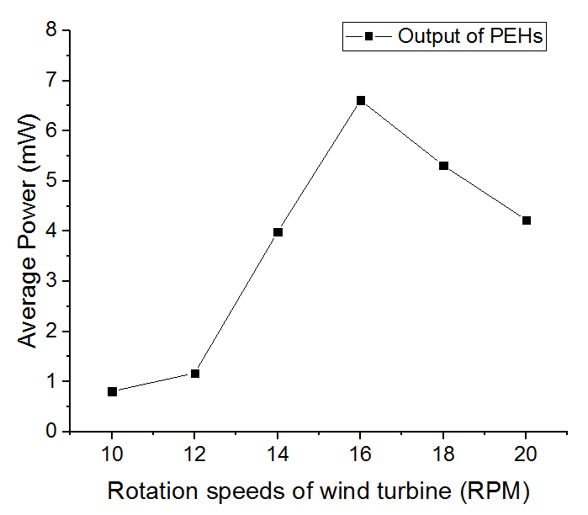
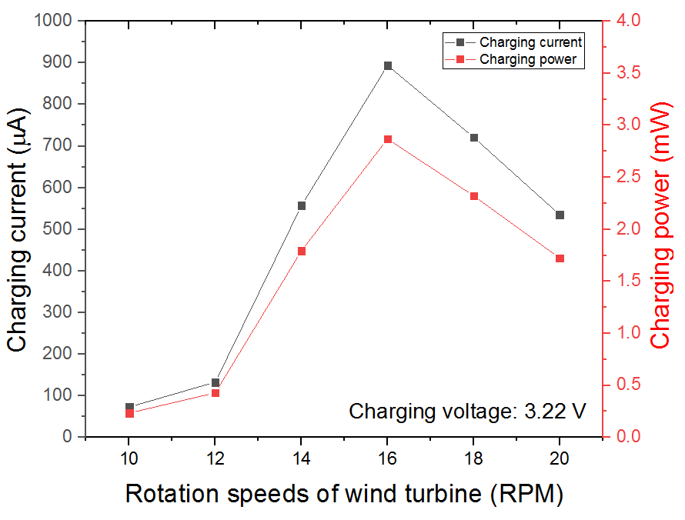
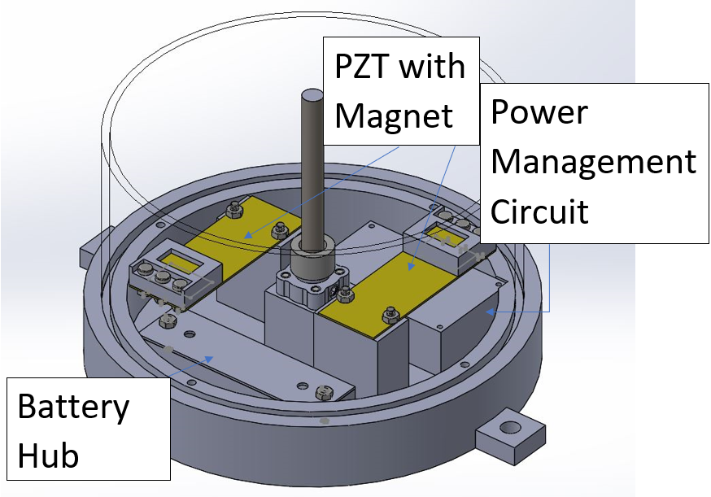
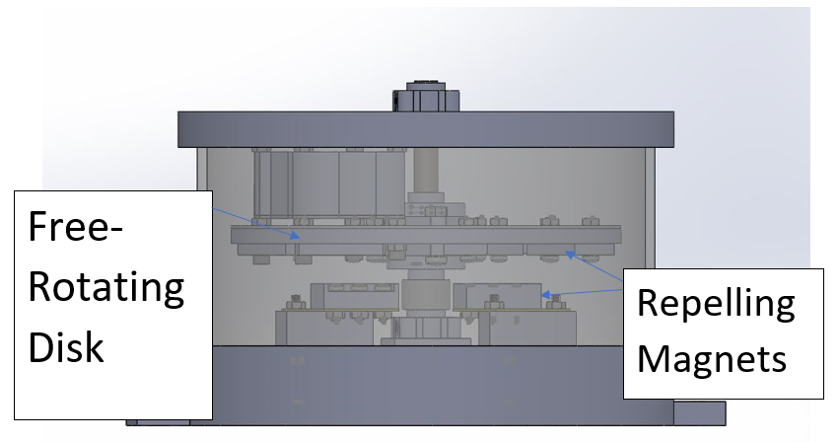
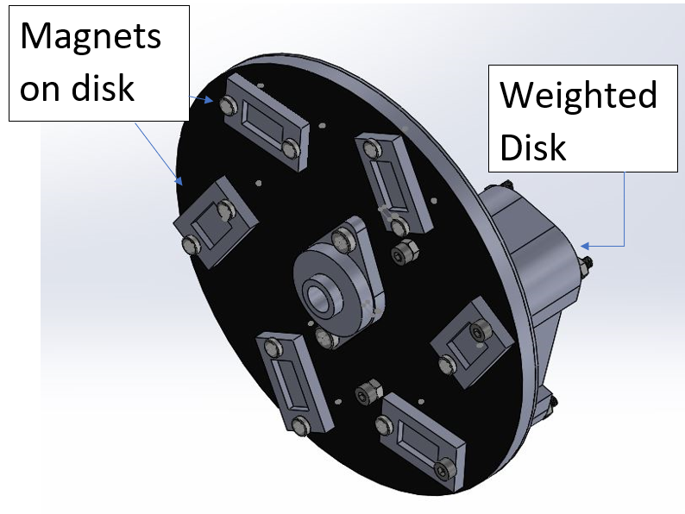
Piezoelectric Energy Harvesting Research For Self-Sustainable Wind Turbine Monitoring Systems
Miles Smith, Alexander Gliese, HyunJun Jung, and Soobum Lee
Department of Mechanical Engineering
Background
Current Problem:
Wind energy is still costly due to high maintenance cost, notably the cost to replace sensors (used to detect cracks and damage within a wind turbine) is very high.
Current wired sensor networks:
Increase the risk of lightning attraction.
Low durability
Current wireless sensor networks:
Dependent on batteries that are difficult to replace.
The Piezoelectric Solution:
A piezoelectric transducer (PZT) could convert mechanical stress into electric potential (voltage), which could then be turned into a power.
Using ambient energy from the rotation of a wind turbine, usable power can be created from a PZT.
Research Question
Can a piezoelectric energy harvesting system be used to replace batteries for sensors to reduce maintenance costs?
Methods
A scaled wind turbine system was used to determine the power output of the system during rotational speeds of a wind turbine (10 to 20 RPM).
Conditions of the piezoelectric energy system optimized to maximize power output including:
Gap between the magnets on the rotating disk and on the PZT,
Weight of the unbalanced disk
Number of magnets on the disk
Electrical Resistance
Results
Resistance = 30 kΩ.
Unaltered power output based on Ohm’s Law (P = V²/R, where P is power, V is voltage and R is resistance).
The current power management circuit (PMC) operates at an approximate efficiency of 47.6%, which results in a reduction of power output.
Discussion
Target output power was 3 mW.
Achieved by the combination of 2 PZTs, before PMC was applied.
Suggests the potential for battery replacement in sensors.
Inconsistent power output at different rotational speeds.
Power output peaked at 16 RPM.
Significant decrease under 14 RPM.
Future Directions
Energy harvesting system should be improved to have a more consistent power output at different rotational speeds.
Size and cost both could be significantly reduced.
Reducing the system from 2 PZTs to 1 could help to significantly reduce cost and size if power level could be maintained.
Acknowledgements
This work was funded, in part, through an Undergraduate Research Award from the UMBC Division of Undergraduate Academic Affairs, as well as, through the Louis Stokes Alliance for Minority Participation. A special thanks also to Dr. Soobum Lee, the principal investigator of the Energy Harvesting and Design Optimization Lab at UMBC for leading this research.
Max:
6.48 mW
Max:
2.87 mW
Average:
1.56 mW
Average:
3.68 mW

